Slide 1
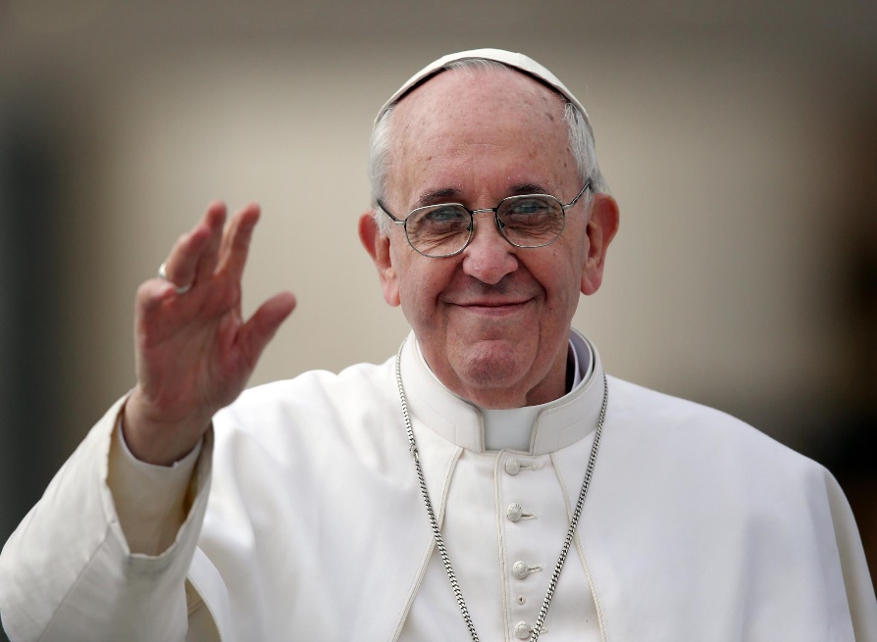
Laudato Si’
Praise be to you, My Lord
A Letter from
Pope Francis
School Assembly
Resource

Slide 2
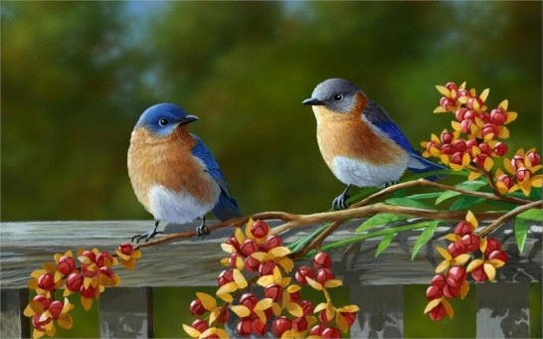
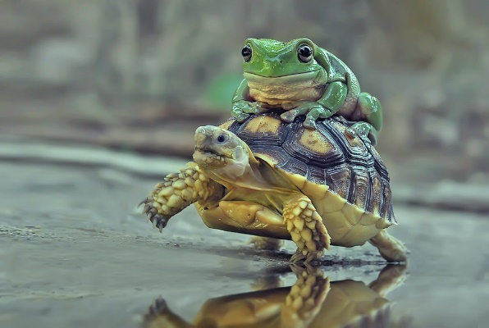
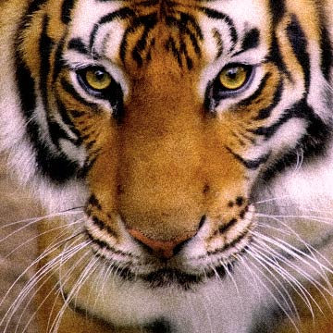
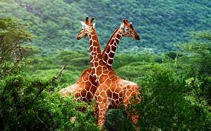
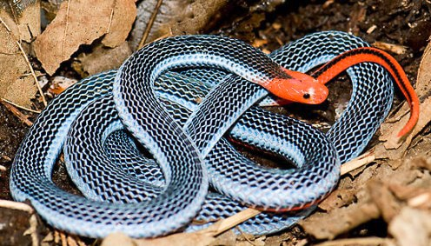
Laudato Si’, mi Signore
The Letter takes its name from
St. Francis’ prayer:
‘Canticle of the Creatures’
‘Laudato si’, mi Signore
cum tucte le Tue creature’
“Praise be to you, my Lord
through all your creatures”

Slide 3
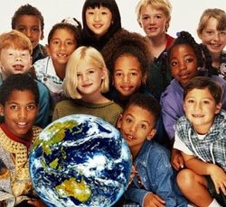
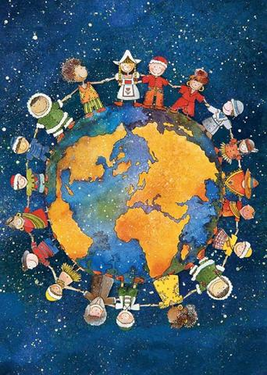
Laudato Si’
Laudato Si’ is subtitled: “On Care for Our Common Home”
it was sent out in June 2015
is addressed to “every person on this planet” (LS no3)
that means it is a letter to all of us here – to YOU and to ME

Slide 4
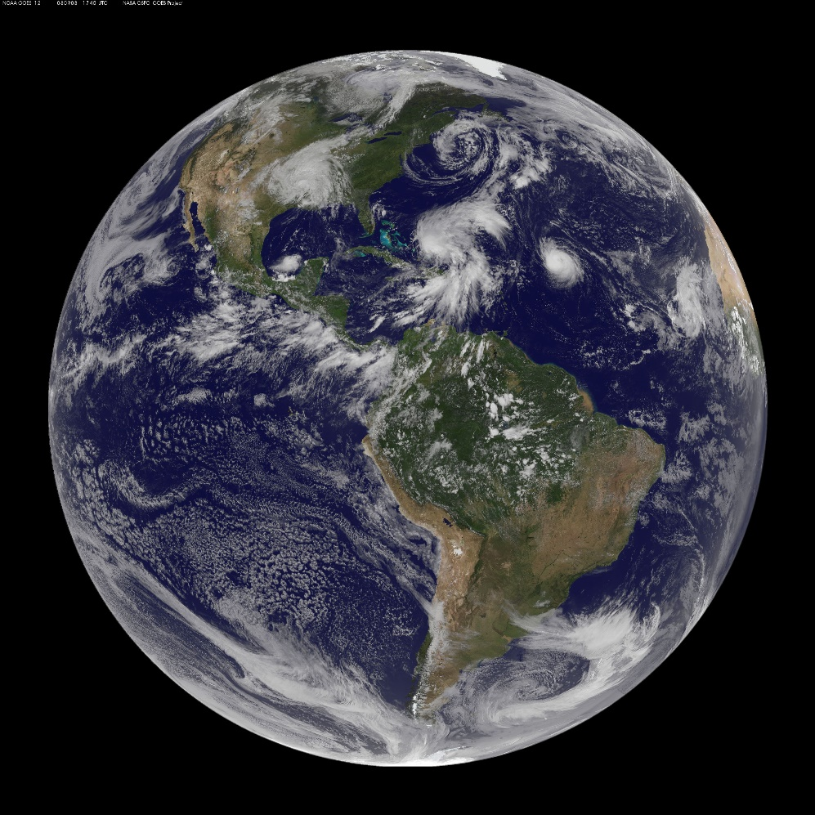
Laudato Si’ - to Everybody
What does Pope Francis say to us in his letter?
He tells us that he is very worried about our home –
Planet Earth
And Pope Francis says that WE should be worried too.
WHY?

Slide 5
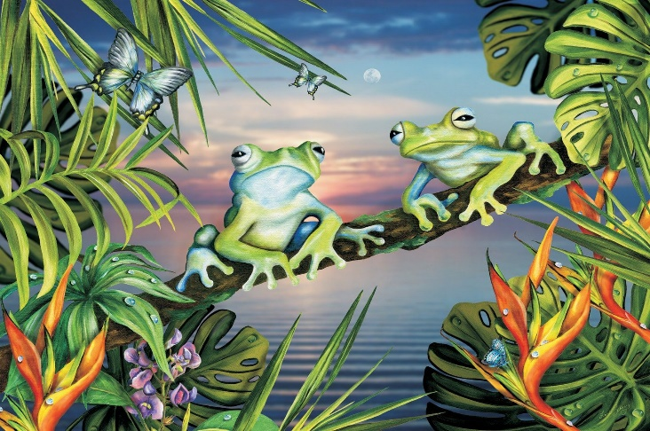
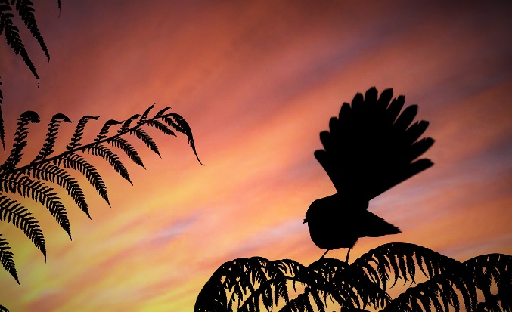
Laudato Si’ – the Planet
Pope Francis, ‘drawing on the results of the best scientific research available today’, says that:
we are using too much of our planet’s resources
we are not taking care of our beautiful world – its forests, rivers, seas and bush

Slide 6
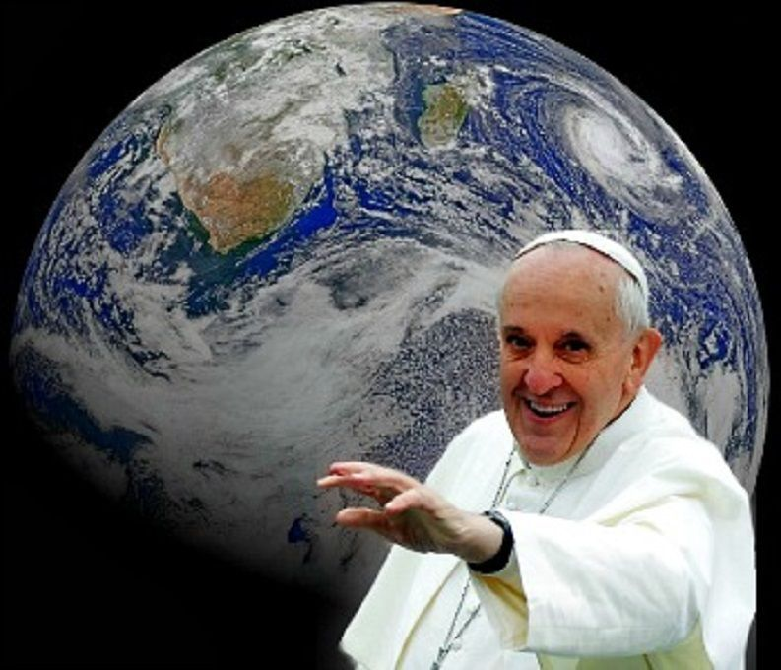
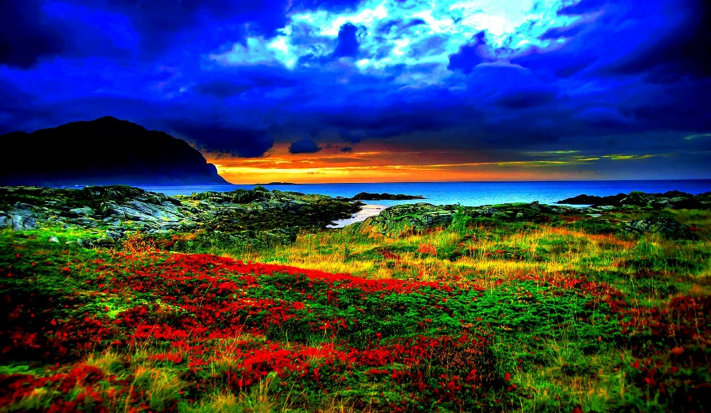
Laudato Si’ – Responsibility
Pope Francis says:
We have a responsibility to care for the environment and everything in it (LS 67)

Slide 7
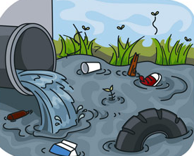
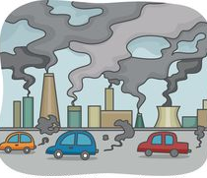
What are we doing?
One of the worst things harming our world is
Pollution
Pollution is anything that is introduced into an environment that can cause it harm

Slide 8
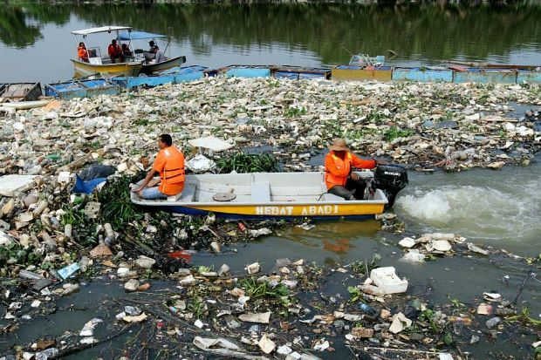
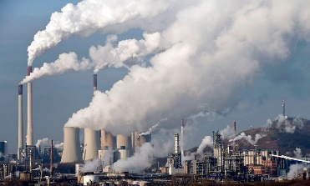
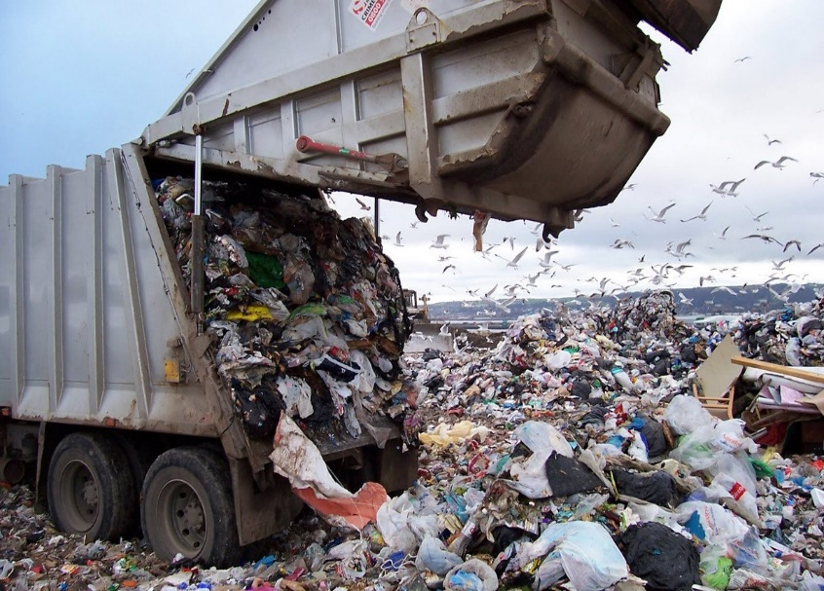
Pollution
We are polluting
our AIR – with poisonous gases
our EARTH – with millions of tons of rubbish
our RIVERS, LAKES and OCEANS – with rubbish, chemicals, oil, sewage from toilets AND……..
PLASTIC

Slide 9
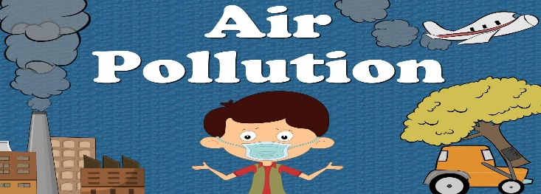
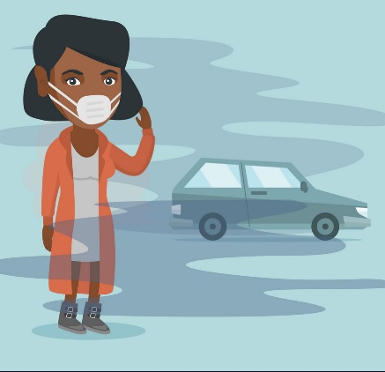
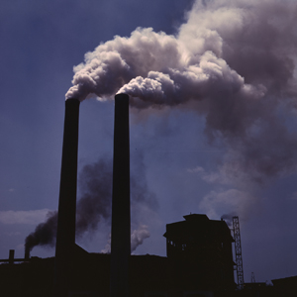
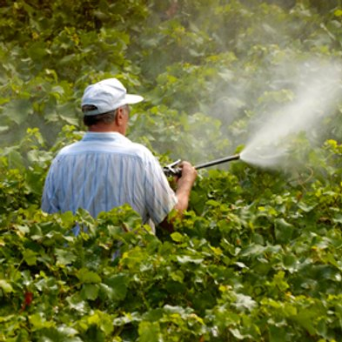
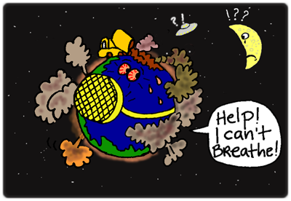
Pollution
We are polluting our AIR with poisonous gases from:
smoke by burning coal, oil and gas
transport - cars, buses planes
sprays and fumes - insecticides, fertilisers, industrial fumes

Slide 10
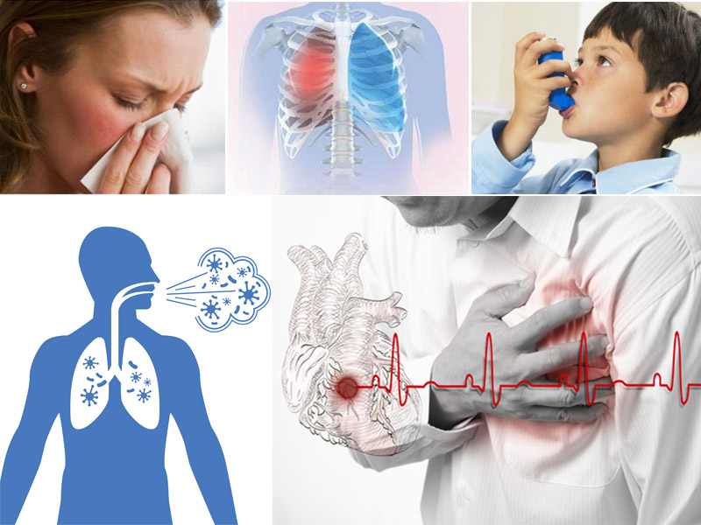
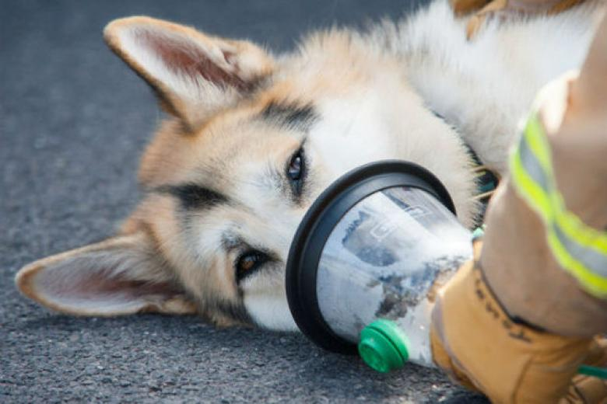
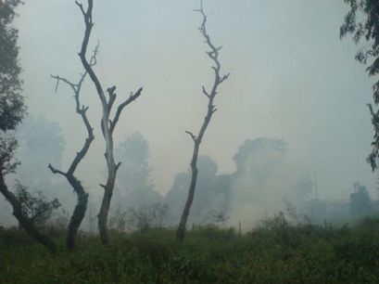
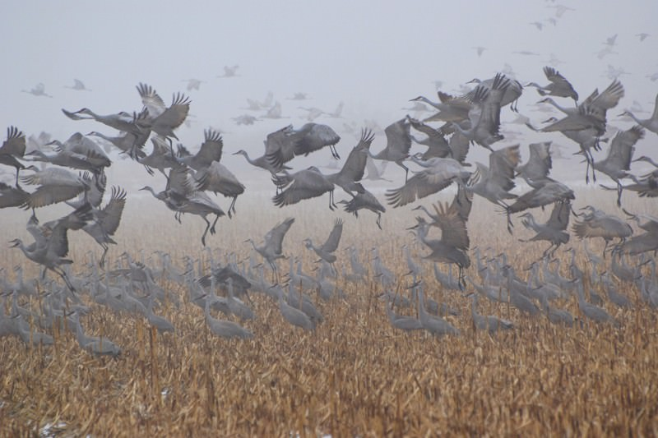
Air Pollution
How does air pollution affect:
People
Animals
Birds
Plants

Slide 11
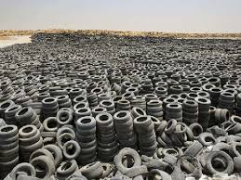
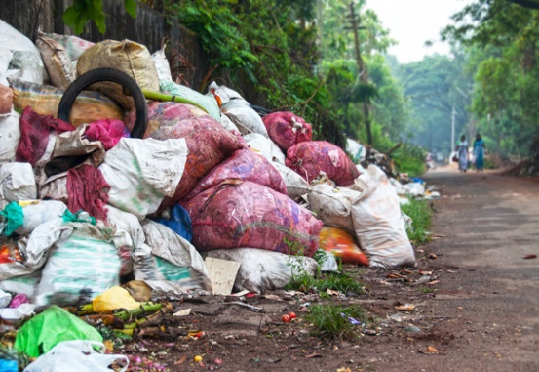
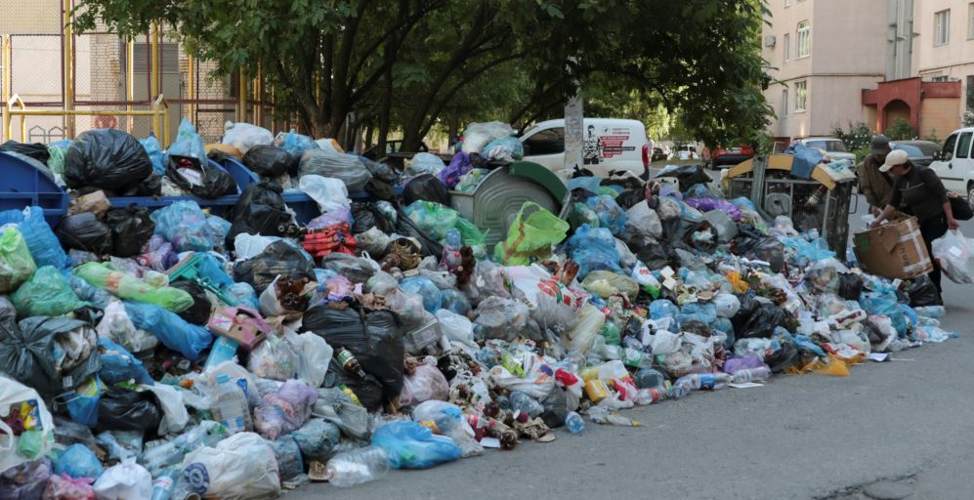
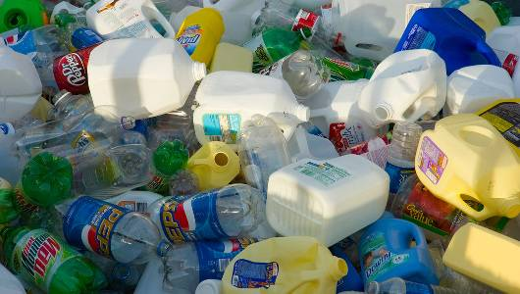
Pollution - the Earth
Rubbish – millions of tons of waste from people, homes, shops, factories and buildings lie all over our planet

Slide 12
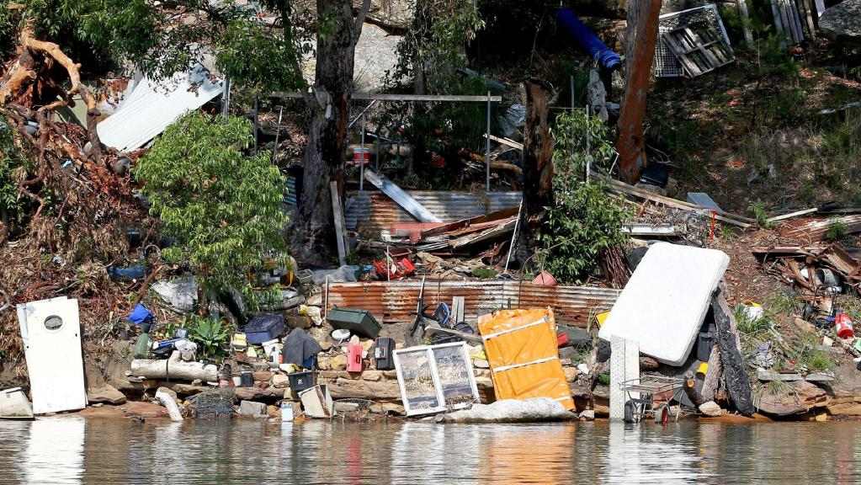
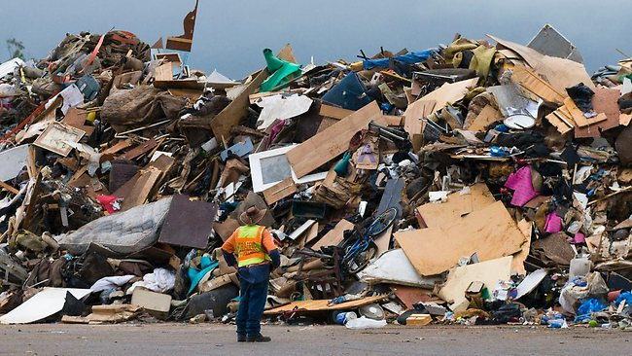
Our Common Home
‘The earth, our home, is beginning to look more and more like a pile of filth’ (LS 21)
Earth belongs to God and is on loan to us
(LS 67)
12

Slide 13
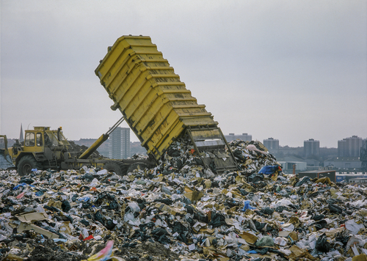
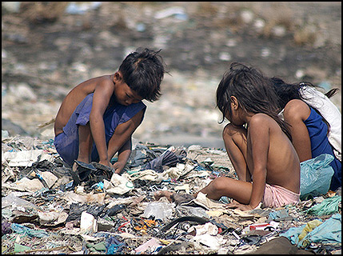
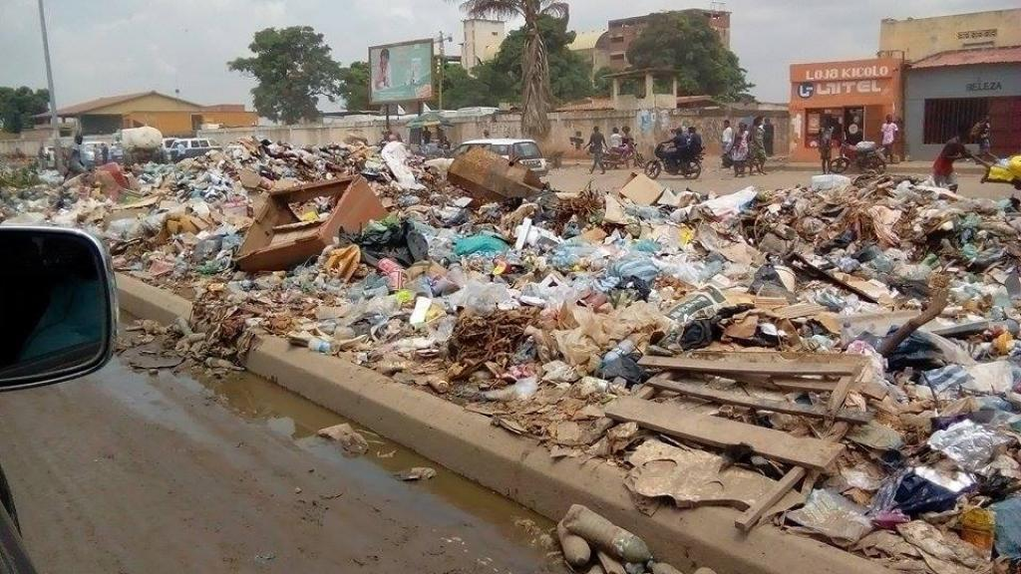
The Earth – Our Common Home
Why do you think we have so much rubbish nowadays?
What can we do about it?

Slide 14
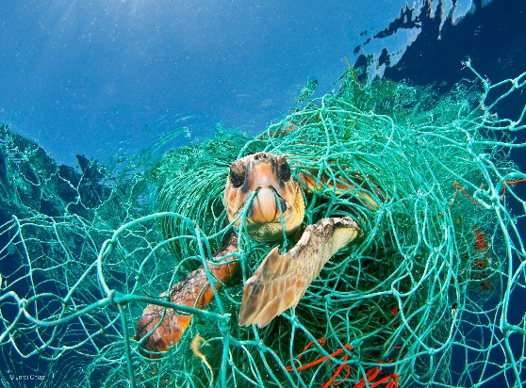
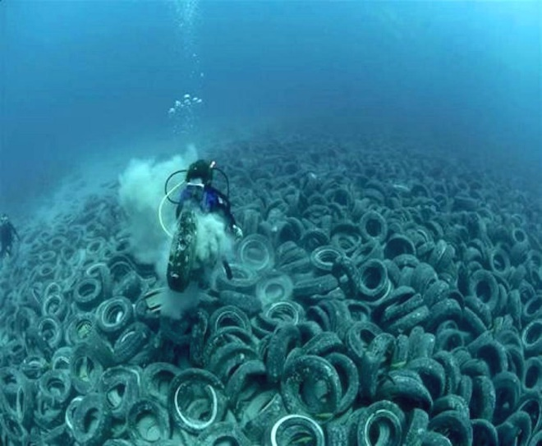
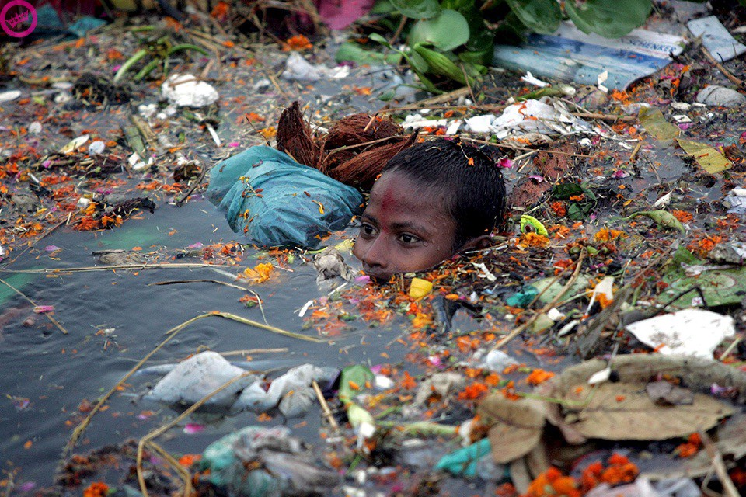
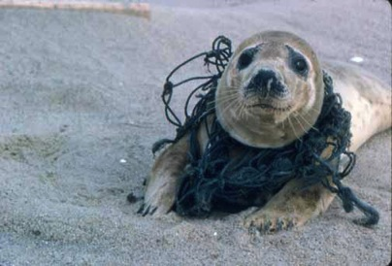
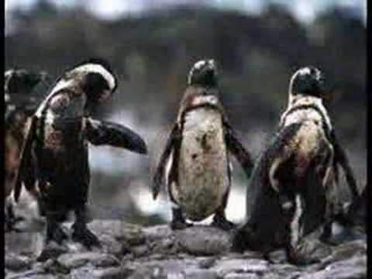
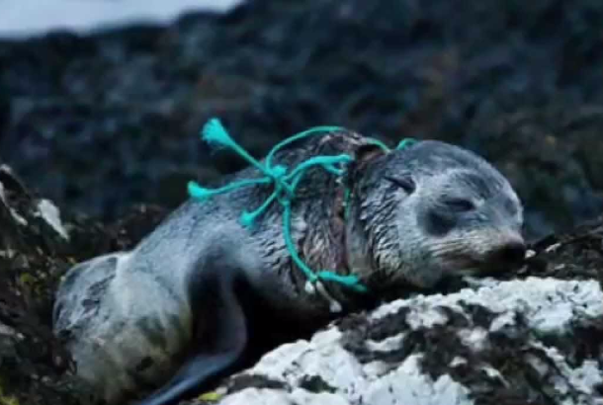
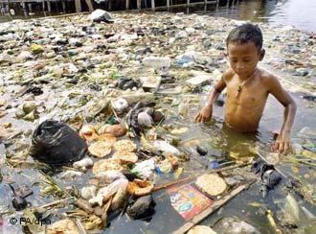
Sea Pollution
How bad is it?

Slide 15
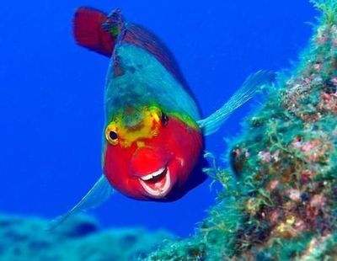
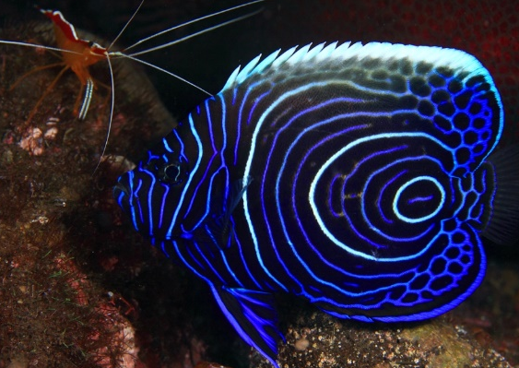
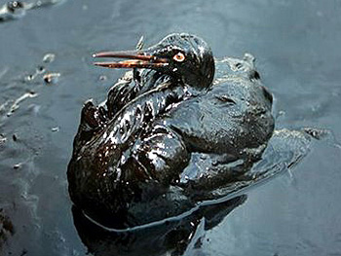
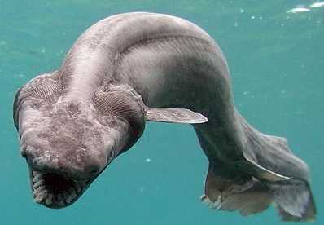
Ocean Life
Oceans contain: (LS 40)
most of our planet’s water supply
an immense variety of living creatures
most of them are still unknown to us
marine life – birds and fish - are badly affected by pollution of the oceans

Slide 16
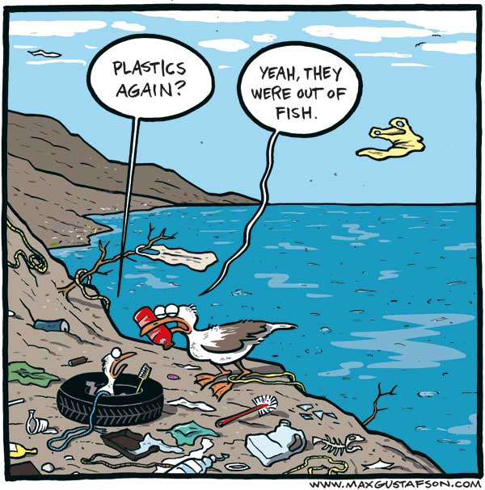
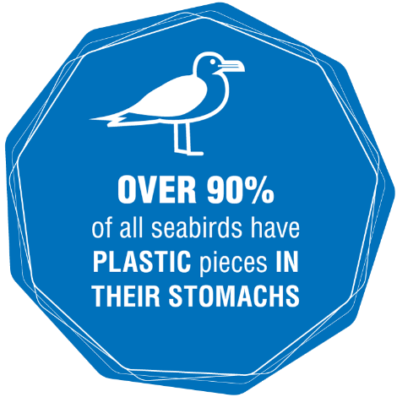
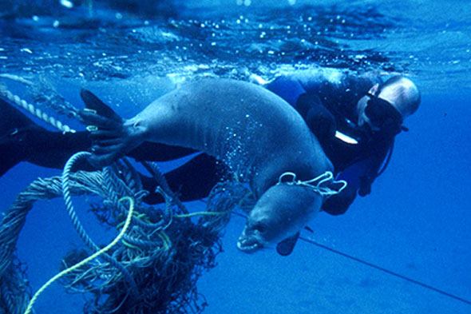
Pollution of the Oceans
There are many kinds of pollution in the oceans
rubbish
chemicals
oil
sewage from toilets and….
PLASTIC –
birds, marine mammals, and
fish are most affected by
plastic in their diets

Slide 17
Pollution - how did it get there?
How does all this rubbish and pollution get into our seas and oceans?
What can we do?

Slide 18
Our Air, Earth, Oceans and Us
Pope Francis says that everything on the planet, including people, are all connected.
We need to think about our actions and how they affect other people and our surroundings.

Slide 19
What can we do?
What are some of the things that WE could do to improve this situation?
Discuss: re-use, recycle, reduce
refuse (say, “NO!”)

Slide 20
What can YOU do?

Slide 21
What can I do?
All it takes…..
All it takes is for
one good person
to restore hope (LS 71)
Can I be that one good person?

