Slide 1
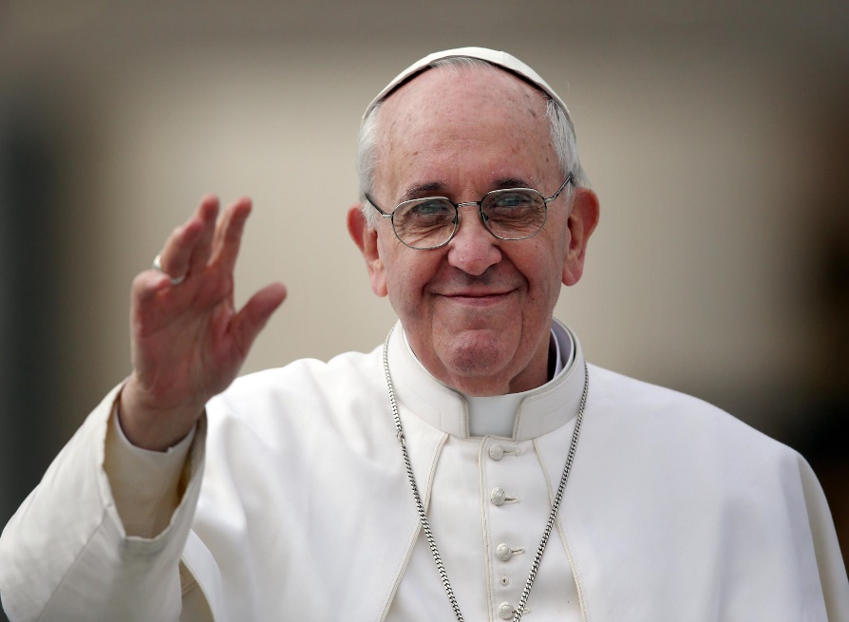
Laudato Si’
Praise be to you, My Lord
Lesson 2
Resource

Slide 2
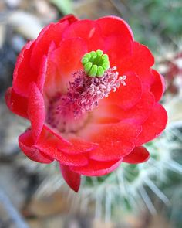
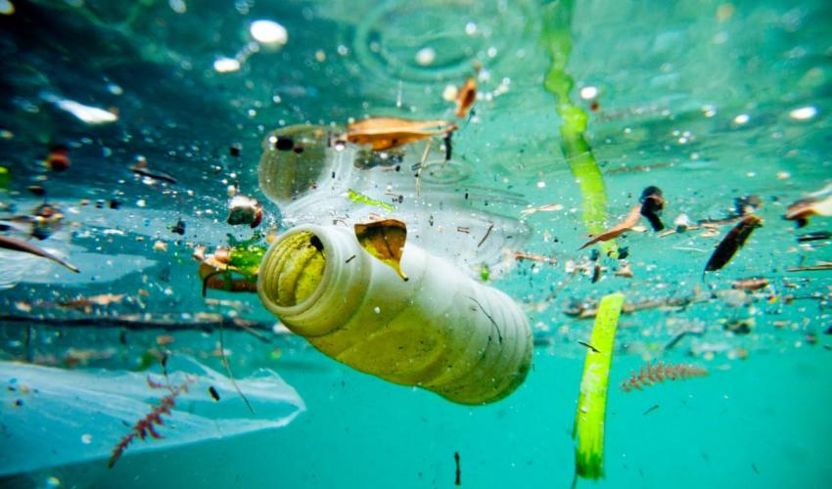
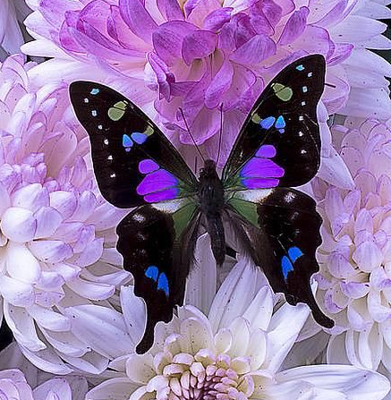
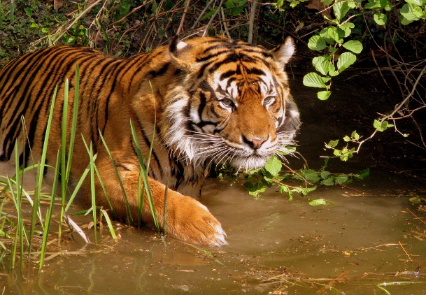
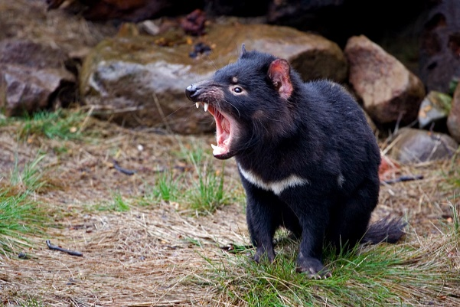
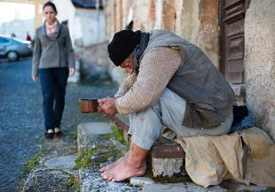
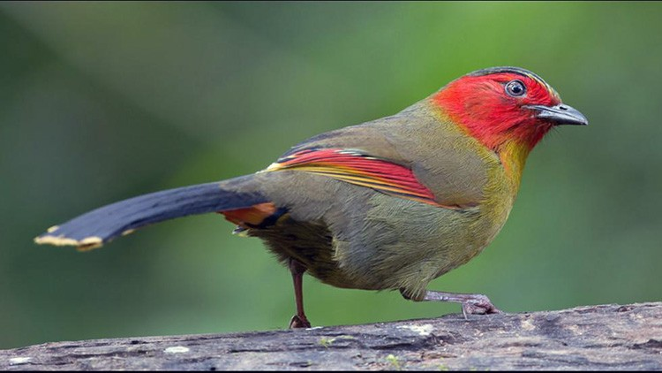
Laudato Si’
Pope Francis in Laudato Si’ tells us how worried he is about the state of our planet:
pollution of our air, our earth, our rivers, lakes, seas and oceans
not caring for and protecting our environment – our plants, animals, birds and marine life – many of which are in danger of extinction
not caring for the poor and vulnerable in our world

Slide 3
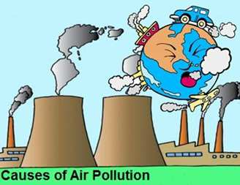
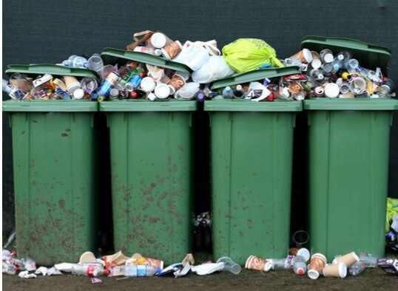
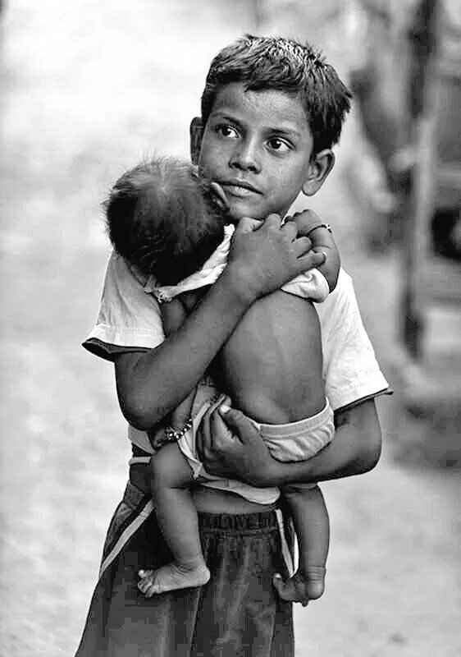
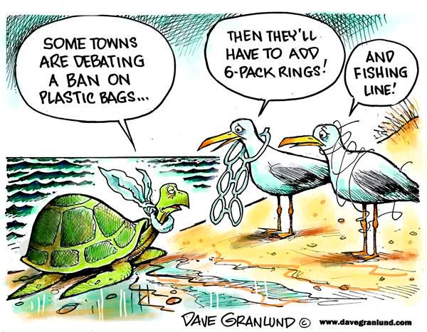
Pollution
In Resource 1 – we looked at pollution of:
our air – noxious gases
our earth - rubbish
In this lesson we will look at:
pollution of our oceans, seas, lakes and waterways
conservation of wild life
consideration of the poor
what we could do

Slide 4
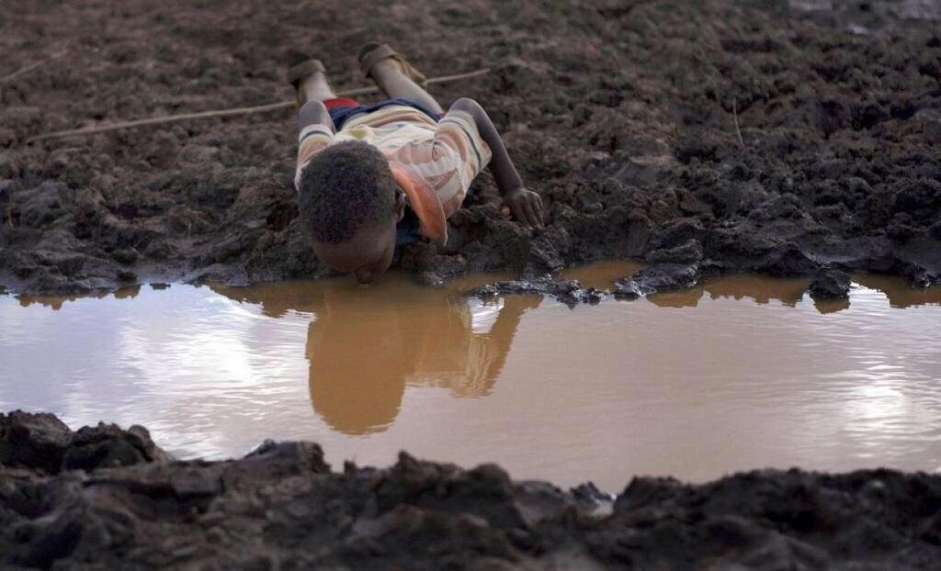
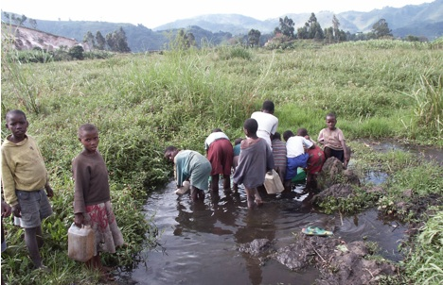
Pollution of Water
Fresh drinking water – many people do not have access to fresh drinking water.
Unsafe drinking water causes many illnesses, disease and death in poor countries.
Many waterways and rivers are polluted.
Safe, drinkable water is a basic human right. (LS 30)

Slide 5
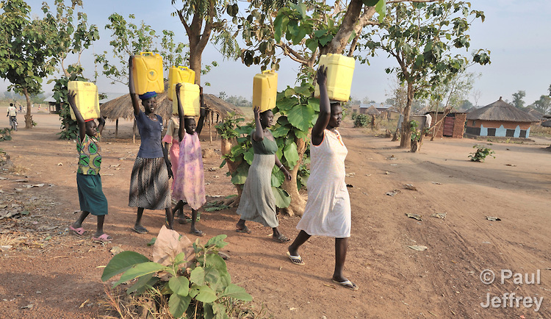
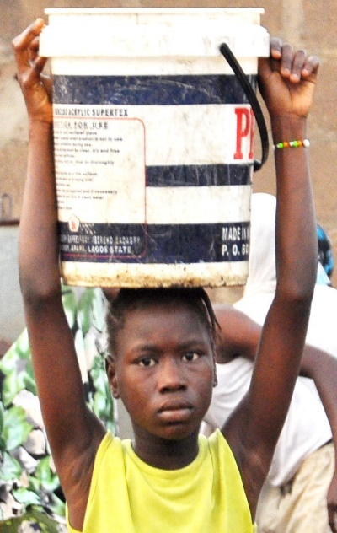
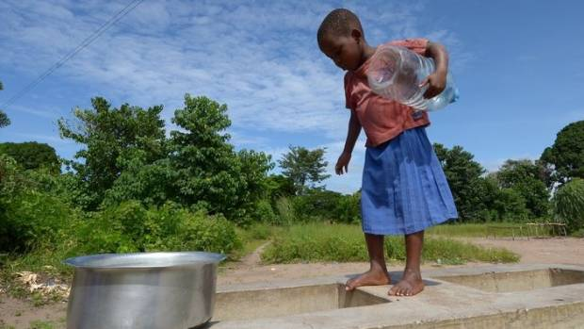
Water – a basic human right
In many poor countries the task of collecting water falls mainly to women and girls.
Many girls cannot attend school because the walk to the source of their water is a long distance away and takes hours each day.

Slide 6
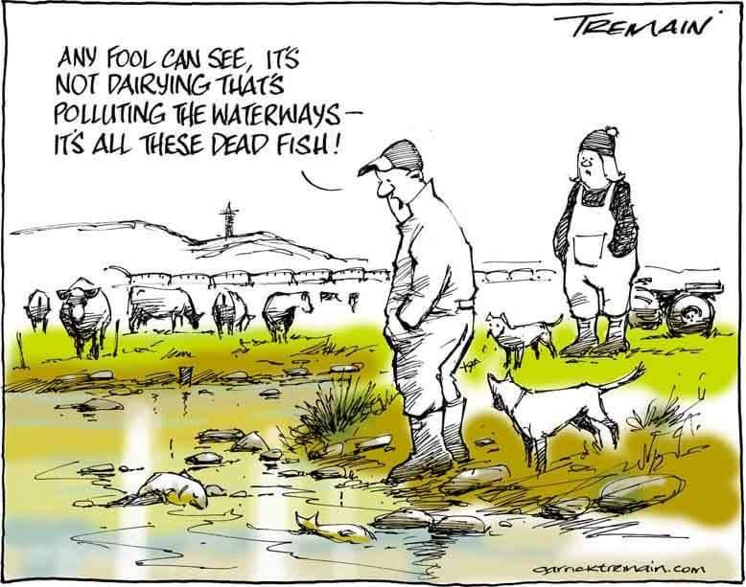
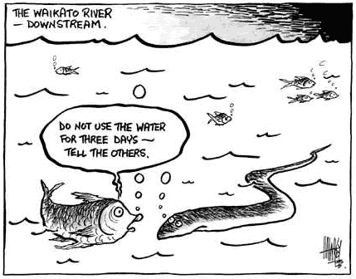
NZ Water Pollution
Many NZ rivers, lakes and beaches are polluted and unsuitable for swimming:
run-offs from fields, roads
discharges from industries
burst/flooded domestic sewerage ……………..ETC….
everything that goes down the drain ……………..
all end up in the river/sea

Slide 7
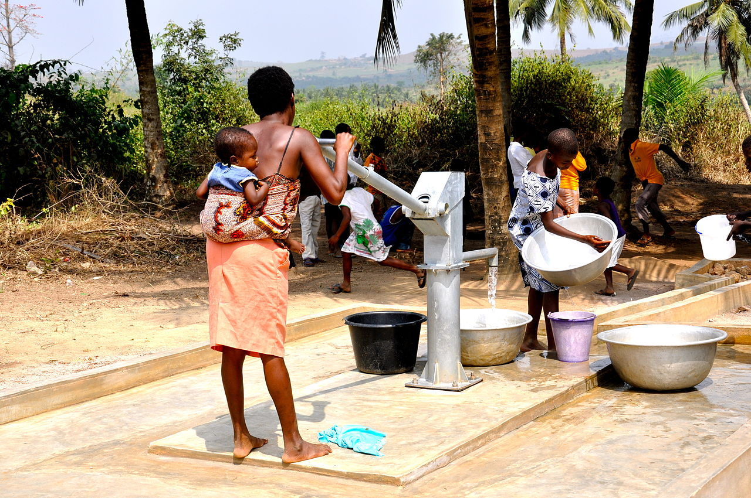
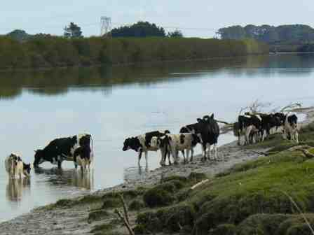
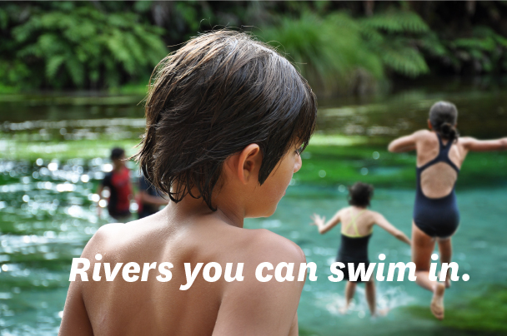
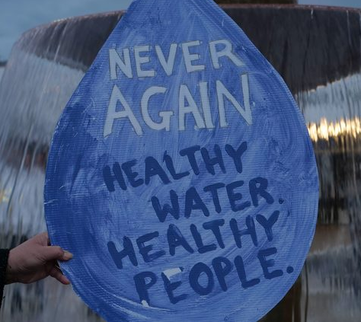
What can we do?
We could raise money to sponsor a village well so that people have easier access to clean, safe drinking water
We have to make sure our own waterways and rivers are clean and safe
Never swim in
polluted waters

Slide 8
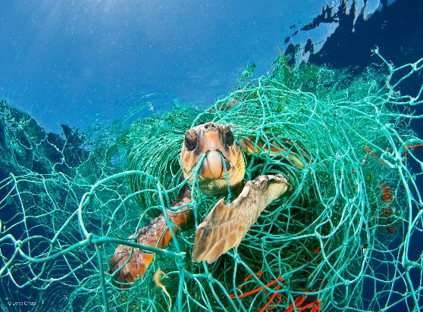
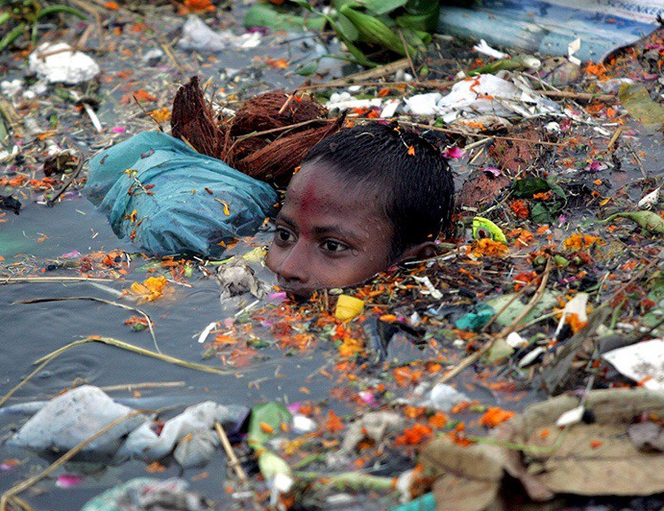
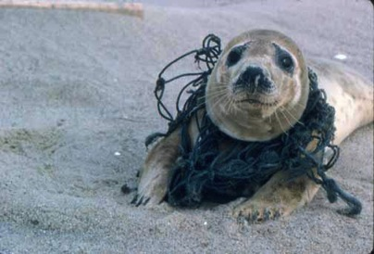
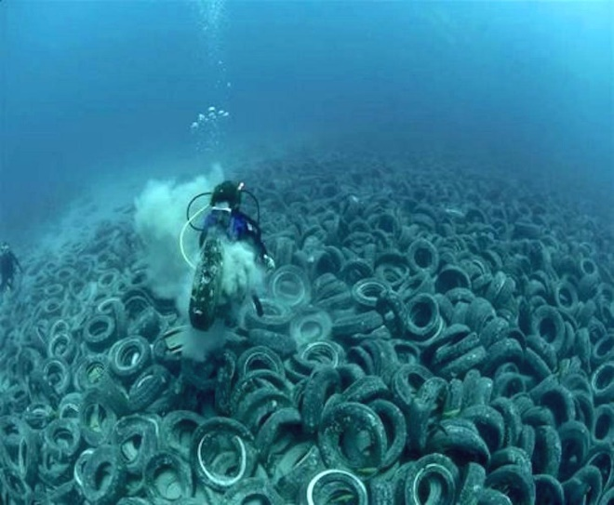
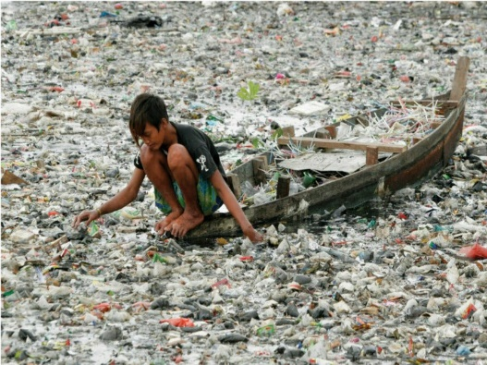
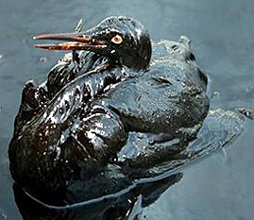
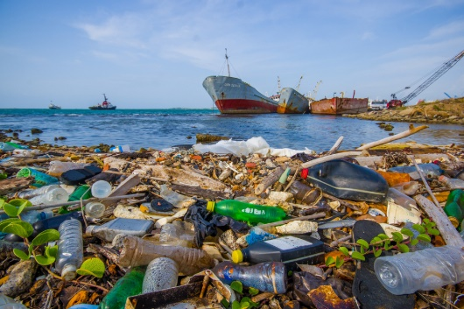
Sea Pollution
How bad is it?

Slide 9
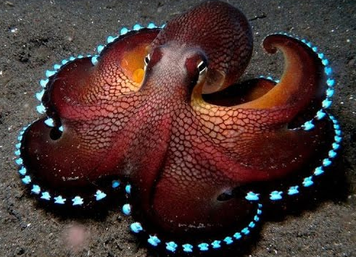
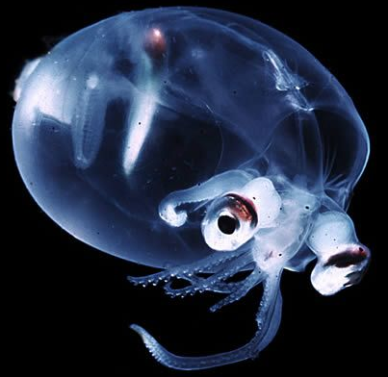
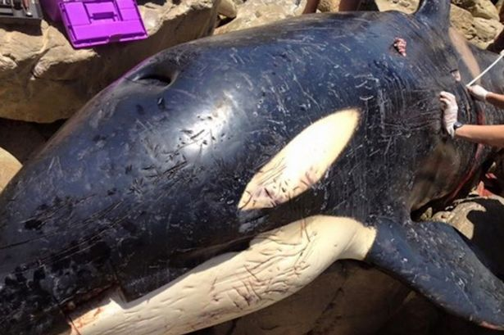
Pollution of the Oceans
Oceans contain: (LS 40)
most of our planet’s water supply
an immense variety of living creatures
most of them are still unknown to us
Marine life, which feeds a great part of the world population, is affected by pollution and uncontrolled fishing, endangering sea life.
Dead orca with stomach full of trash

Slide 10
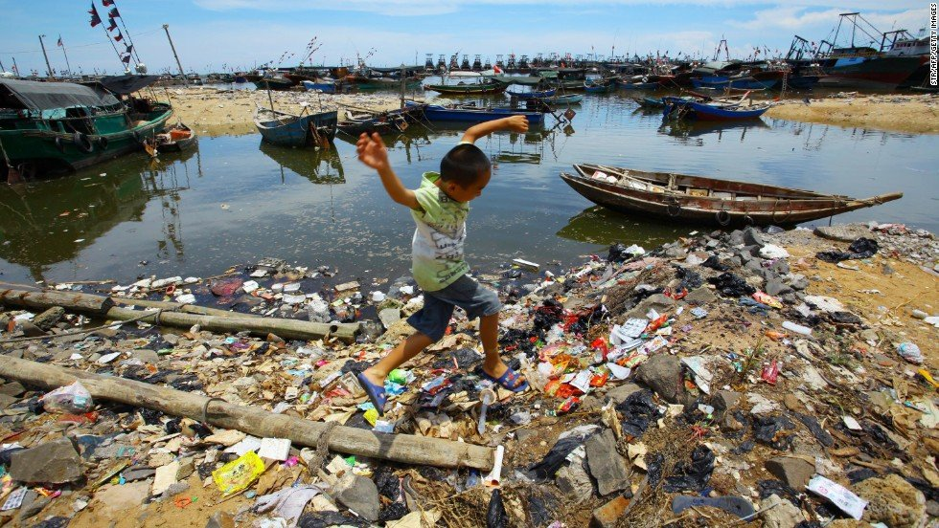
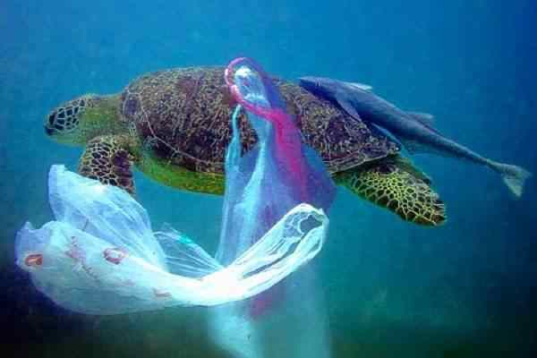

Slide 11
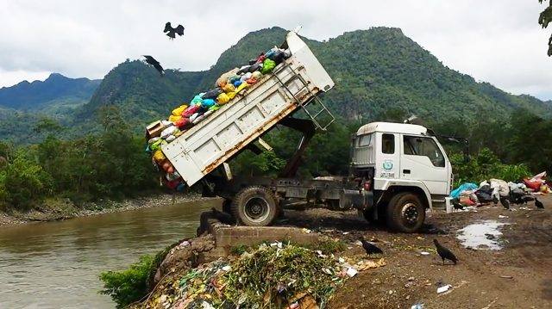
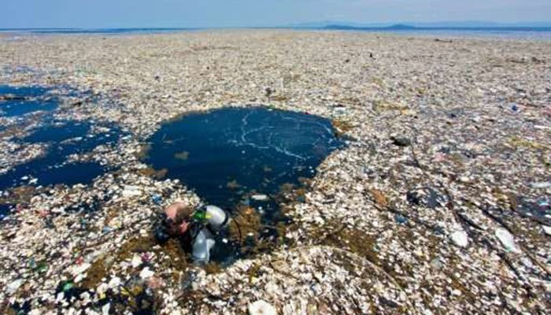
Sea Pollution - how bad is it?
60-90 percent of marine litter is plastic-based
At least 8 million tons of plastic enter the oceans each year
80% of ocean pollution is from land based sources
There is more microplastic in the ocean than there are stars in the Milky Way
Over 100,000 marine animals die every year from plastic entanglement and ingestion
Ocean pollution kills more than one million sea birds each year
Dumping trash into the Amazon
Trash Island in the Caribbean

Slide 12
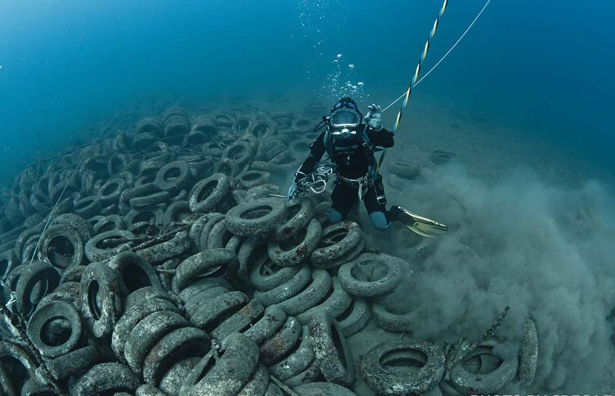
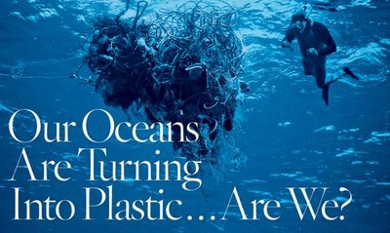
Pollution of the Oceans
There are many kinds of pollution in the oceans and seas:
rubbish, chemicals, oil, sewage from toilets and….
PLASTIC – birds, marine mammals, and fish are most affected by plastic in their diets
this in turn affects all the other creatures that eat the birds and sea creatures – including US

Slide 13
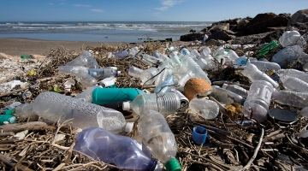
Pollution of Water - what can we do?
Never leave rubbish lying around on beaches or beside rivers and lakes
Never throw rubbish into the sea or into rivers or lakes
Organise or help in a beach clean up
Help to take care of a local stream
Make sure only rain water goes down the drain - most drains flow straight to the sea
Conserve water – turn off taps

Slide 14
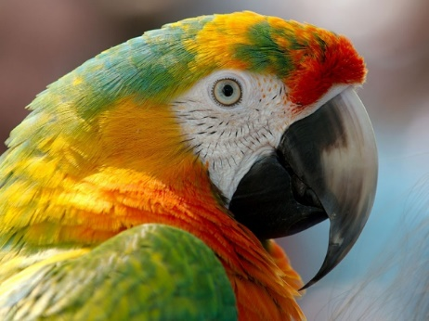
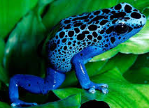
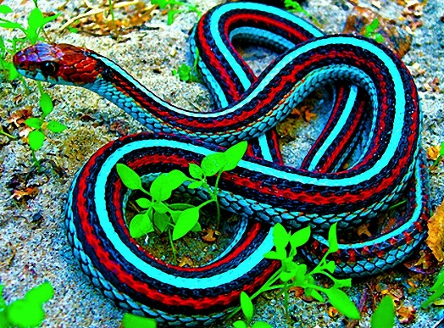
The Loss of Biodiversity
Each year thousands of plant and animal species disappear, becoming extinct due to human activity. (LS 33)
The cause is usually due to economic interests of greedy people trying to make more money. (LS 34)

Slide 15
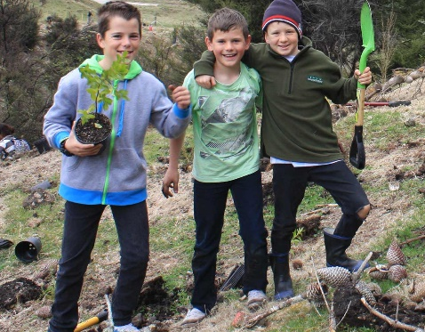
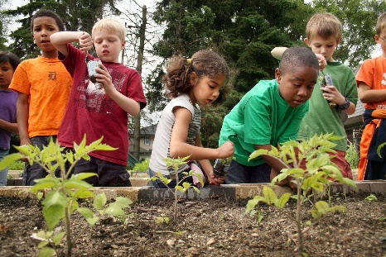
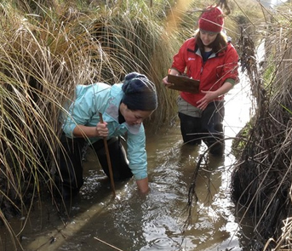
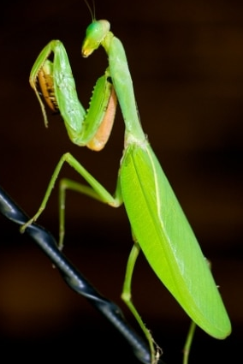
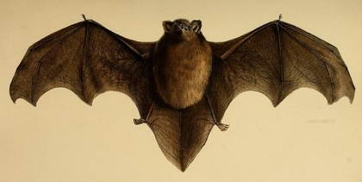
What can we do?
We could:
become actively involved in protecting endangered animals and plants
plant more trees and flowers
work to keep streams and waterways clean
protest about sprays and insecticides that kill off many species
Take care that we don’t cause harm to insects, birds and mammals

Slide 16
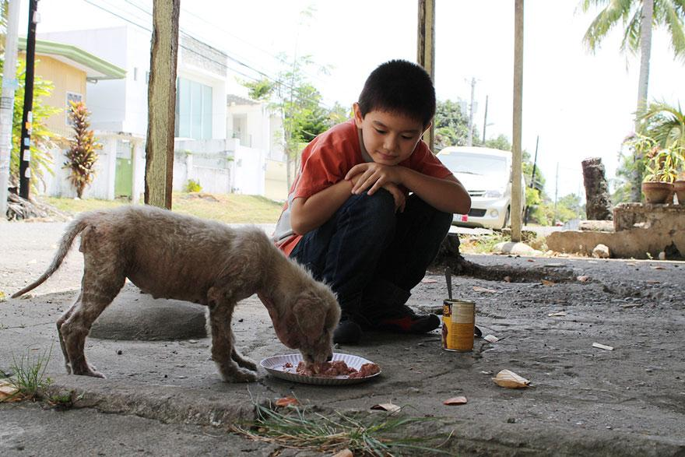
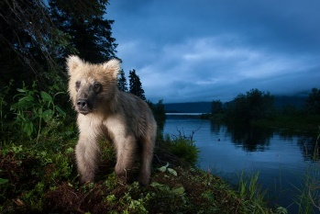
What else can we do?
Every act of cruelty towards any creature is ‘contrary to human dignity’ (LS 92)
never be cruel to any living thing
Approach nature with awe and wonder (LS 11)
be aware of God through the beauty and goodness of God’s creatures and nature
Practise St.Thérèse’s little way of love daily – a kind word, smile or small gesture, which sows peace and friendship. (LS 230)
do small, wonderful deeds each day

Slide 17
And what else can we do?
Show respect for each human person, who is endowed with basic inalienable rights (LS 153)
always be kind to every single person, every day
Have an appreciation of the immense dignity of the poorest of our brothers and sisters (LS 158)
treat everyone with dignity and never think you are better than anyone else
All it takes is for one good person to restore hope (LS 71)
be that one good person

Slide 18
But what can I do??
do I always want something MORE?
do I really need to have the latest toy, digital game, phone, shoes?
will my purchase end up in a landfill?
do I try to reduce PLASTIC in my life?
do I think about what I have and be very thankful?
do I take notice of God’s wonderful world and what’s happening to it?
am I showing God’s love to others?

Slide 19
Things must change (LS 202-227)
Consumerism – Christian tradition calls to ecological conversion:
simplify our lifestyles, move away from ‘buy more’
be mindful on all purchasing – consider how our buying impacts on other people and things
be content with the necessities of life
be present to the moment – music, art, beauty, be in tune with God
be aware that ‘the cry of the poor’ is not just from the human family

Slide 20
What can I do?
What can you do?
What is one thing that you will do?

Slide 21
What will I do?
Jesus, through Pope Francis’
letter – Laudato Si’- is calling
YOU
to do
something.

Slide 22
All it takes…..
is…………
one good person
What can I do?
BE that one, good person

