Slide 1
Breaking Open the SREBD
Session - 3
Considering our Learners? Thinking about assessment & ‘Applying Pedagogy’?
Notes:
Quick note – The SREBD has been written with input from NCRS, Bishops, REAs, Teachers, and lots of anecdotal evidence from families and whānau. It has been written to help secondary teachers teach RE – not just to create more work.

Slide 2
Blessing - Karakia
E te Atua, God our loving Father,
You gift us with this world and invite us to respond with love and wisdom
Hehu Karaiti, Jesus Christ, beloved Son,
You show us how to live and call us to participate in your mission of life
Wairua Tapu, Holy Spirit,
You empower us with your will and guide us on our shared journey.

Slide 3
Blessing - Karakia
Bless the children, young people and whānau in our parishes and their Catholic school communities
Bless all who work in Religious Education in Aotearoa New Zealand,
Remind us that you are always with us,
Fill us with enthusiasm, knowledge and joy
To teach and learn that which is at the heart of our schools,
You, who live and reign for ever and ever.
Amene
Notes:
Begin with the Blessing – Karakia at the start of the REBD p4. After praying it draw out some of the aspects that are at the heart of this document.
We acknowledge that God is the foundation and inspiration for our work.
God is with us and gifting us in our work as we respond to Jesus’ Call to participate in his mission.
We ask, first, that the children and families be blessed
We ask that we be blessed in our work.
We acknowledge that for ourselves and our kids, we need to be enthusiastic, knowledgeable and joyful
It is Jesus who is at the heart of our schools and all of us are teaching and learning in our Catholic school community.

Slide 4
Session 3 - Overview
At the end of this session, teachers will have
Considered the Learners in their own school
Reflected on the place & purpose of assessment in RE and
Considered possibilities beyond “classes” and Achievement Standards
as discussed throughout the Religious Education Bridging Document.
Notes:
We’re continuing to just break the surface of this document. The first point we’ll cover in some detail and then touch on the other two.

Slide 5
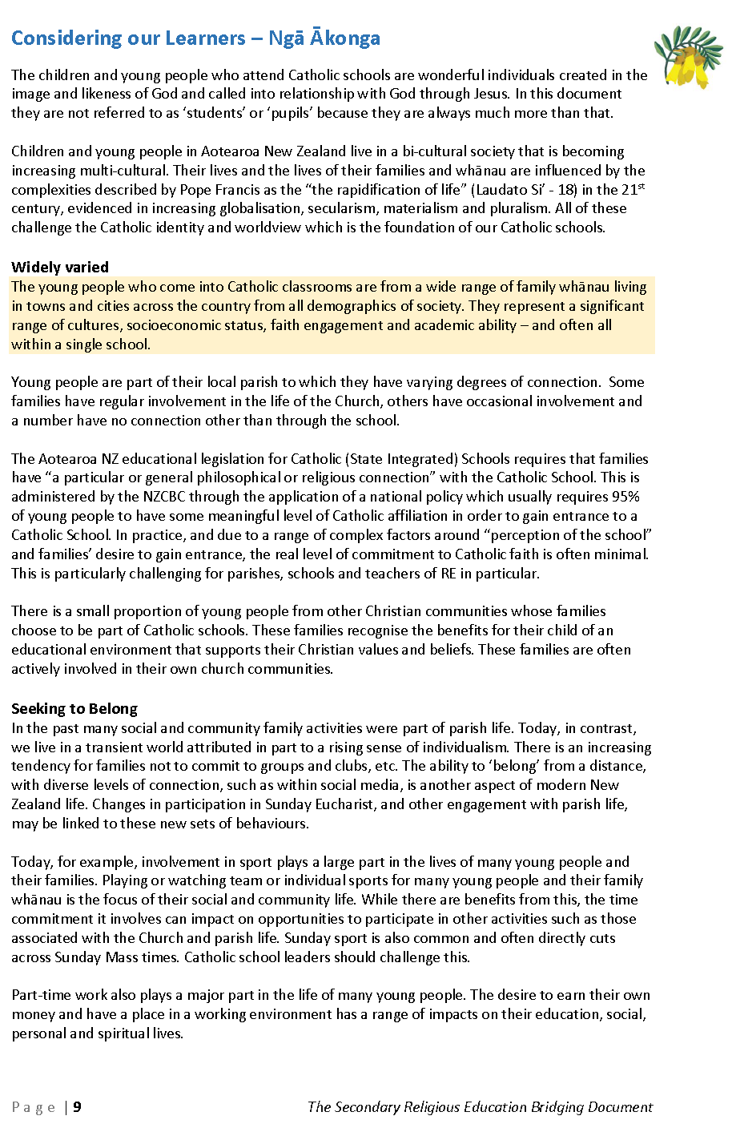
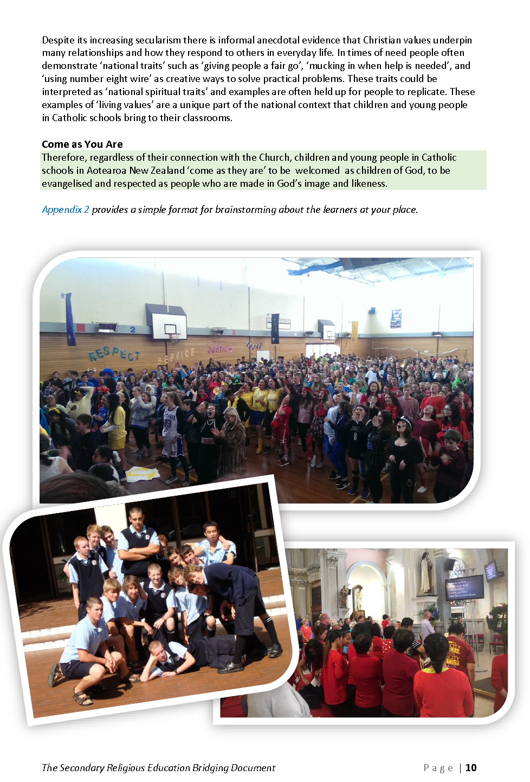
Considering our Learners
2 Minutes
Read pages 9 & 10 of the SREBD.
What ideas, words or phrases leap out at you?
Notes:
Give people the opportunity to quietly read pages 9 & 10.
When everyone is ready click to make the question come up. Get people to spend two minutes talking to the person next to them. Feedback to the large group.
Allow some large group discussion. Make sure people are aware of the key intentions behind this material:
The Bishops know their schools are not 100% full of practicing, faith-filled, engaged, committed Catholics. They actually know the reality.
Children and whānau are complex.
New Zealand is made up of a diverse range of cultures, attitudes and practices.
Note the sub-headings: Widely varied, seeking to belong, come as you are.
All are welcome just as they are.

Slide 6
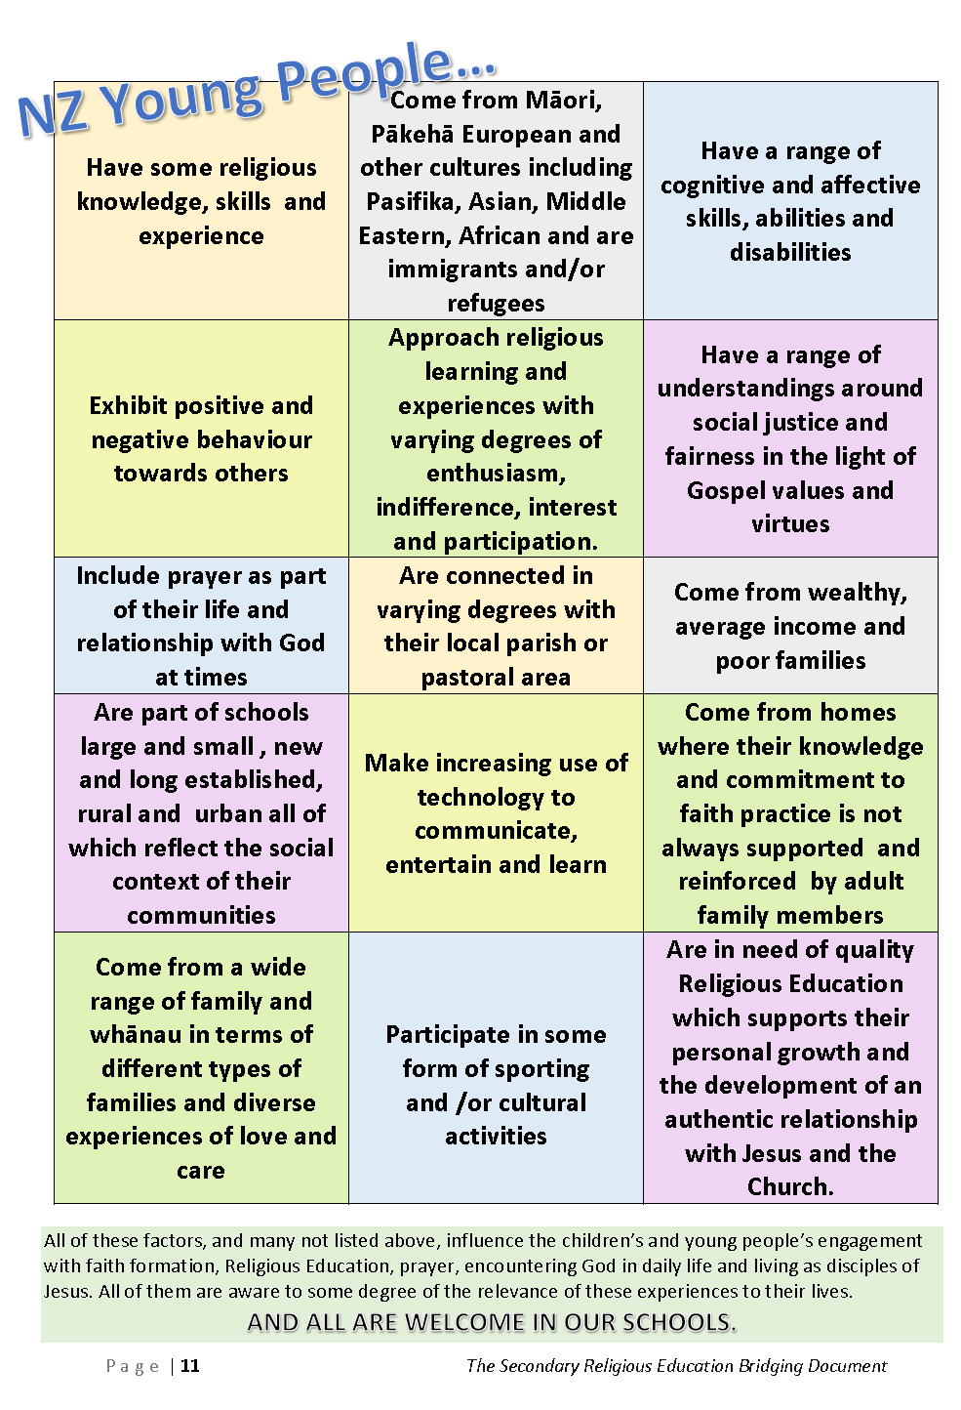
Considering OUR Learners
What might be added to these boxes on page 11?
Get into school or parish groups and name the characteristics of the children at your place – using the template on page 42.
How does this ‘inform’ our teaching of RE?
Notes:
“What might be added” is really just showing that this page isn’t ‘exhaustive’. It helps focus us.
Next click, getting into school or parish groups,
A few key points to be made here:
This is particularly from the perspective of learners in RE. (Yes, there’ll be a lot of overlap with wider Catholic Character anyway.)
We know schools already look closely at their learners, so it will be easy for some. It’s more taking an opportunity to focus together rather than “teach grandparent to suck eggs.”
We’re anticipating that the majority of feedback might highlight the difficulty for teaching RE. (Less churched, lower religious literacy, more cultural diversity, complex family make up, etc.)
The intention is to “Name it” then let it inform what we do. Knowledge to teach RE more effectively, not depress or sap our energy. (Yes, Teaching is hard work. Thank God for teachers. ☺)
Final click – how does this ‘inform’ – allow some general feedback. Just a few examples.

Slide 7
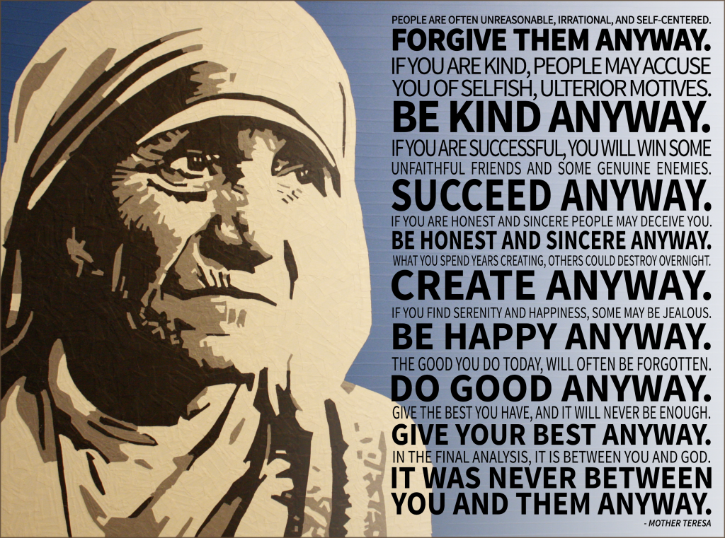
And knowing this…
CHILDREN AND WHĀNAU
MIGHT NOT BE VERY INTERESTED IN
RELIGIOUS EDUCATION
TEACH THEM WONDERFULLY
ANYWAY
Let’s get on with it!
There’s a freedom in choosing to engage joyfully, creatively and skilfully in Religious Education even though, or perhaps, ‘especially because’ it’s challenging work.
There’s a sense of Mother Teresa’s challenge in what we do as teachers

Slide 8
How do we know if we’re doing a good job?
Take a few moments to share?
Some more food for thought…
Have you had similar experiences of your own? Either…
A “Wow” moment where you realised that children from another school were just as wonderful as your own? OR
A “Wow” moment where you really saw Catholic Education shining through.
Notes:
1st click – some more food for thought…, 2nd Audio will start by itself.
The comment by Colin MacLeod (Director NCRS) is not intended to be ground-breaking. This is quite common knowledge, but worth thinking about.
Next clicks - Allow a bit of time for appropriate feedback. The point of this – gently not aggressively - is, “State schools are doing a fine job of turning out lovely young people with good values. It’s our linking values, and virtues, to ‘being Catholic’ & believing in Jesus that is the point of our schools.” Otherwise, we could just close the gates and let the state schools get on with it?” – we know this. ☺

Slide 9
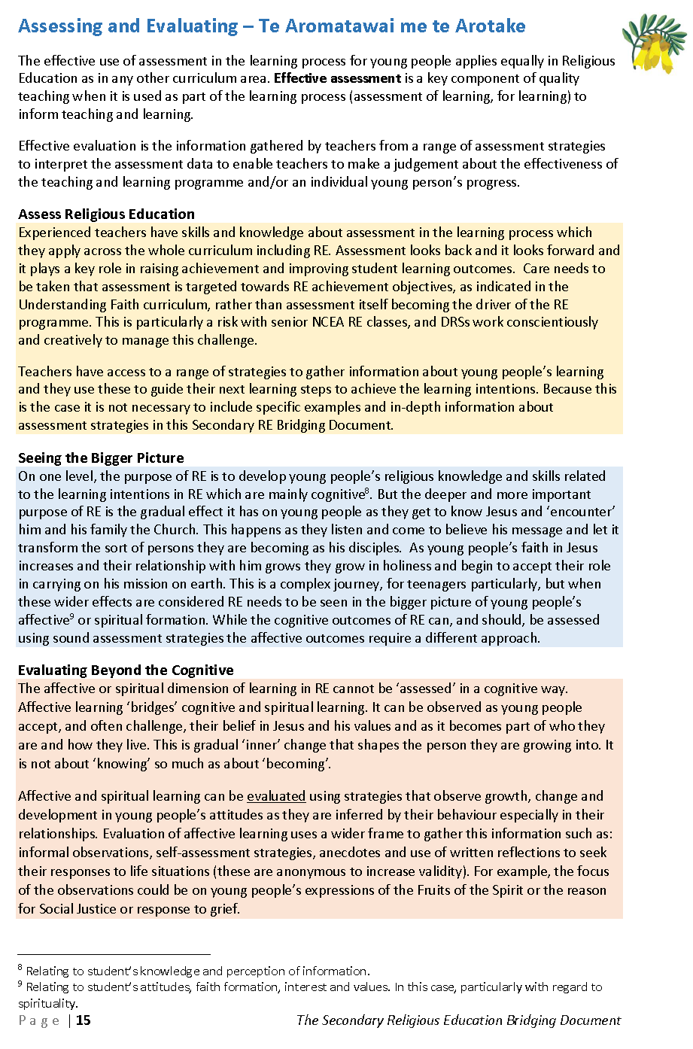
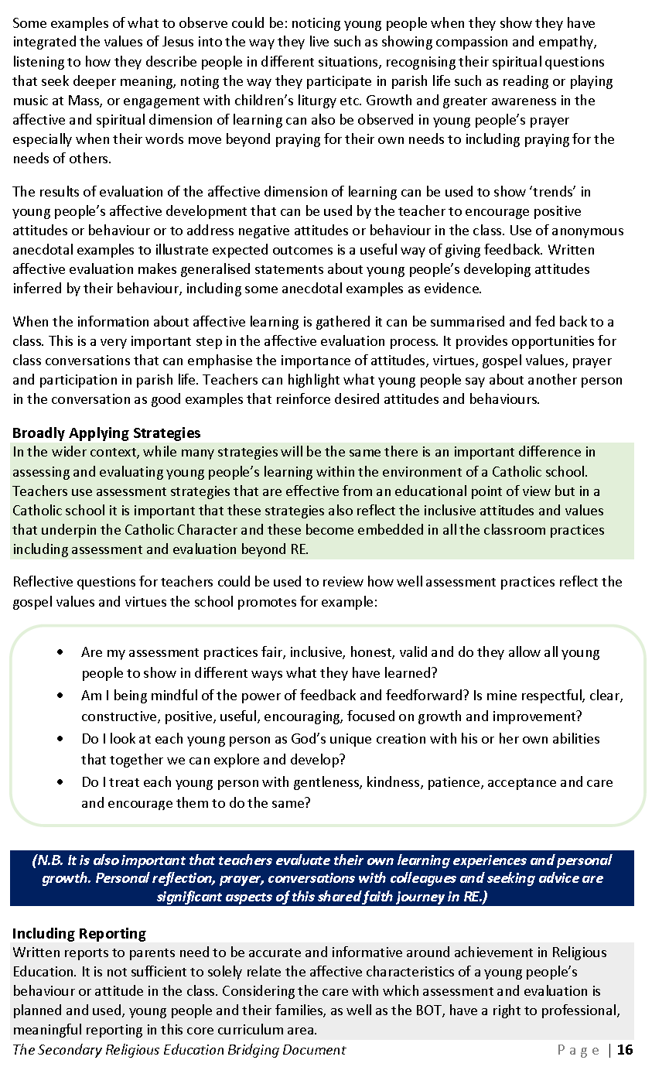
So, what about Assessment then?
It’s really important.
There’s not time now but, read pages 15 & 16 over the next couple of weeks (unless you really want to do it now?)
Take some time to discuss it as a staff.
There are a lot of words but they’re significant.
Notes:
They’ve just finished reading a couple of pages. This is almost too important to dive into now. Pitch it for them to work through, independently, later.

Slide 10
RE Assessment in a nutshell
Teachers know why and how to assess. So, the SREBD intentionally does not go into detail.
The Cognitive. RE knowledge and skills can, and should, be assessed just like any other area of the curriculum.
Curriculum should be driving assessment, not the other way around.
There are massive challenges in the senior school in this regard.
The Affective. We cannot assess faith, but we can and should, take note of how RE is impacting, personally, on the children in our classes.
There are a range of strategies for this.
Notes:
This is really just to open the discussion. There will be a huge range of feeling and understanding about this among teachers. That’s fine. It needs to be ‘nutted out’ as a school community.
Teachers need to take time to work through pages 14 & 15, discuss what it means and decide how this will impact on what they do in their own place. (This could easily be 3 or 4 sessions all on it’s own.)
There may be some desire to enter into discussion in the group around this. But, it’s suggested that this be kept very short and directed back for later discussion. (REAs may choose to take some leadership here later in the year.)

Slide 11
Applying Pedagogy
The SREBD consistently highlights the need for RE to be engaging, creative and effective.
A key intent is to formally “open the door a crack” for RE to move beyond single lessons into more creative and dynamic experiences linking to other areas of teaching and learning.
It also reinforces the need for the Bishops’ mandated Understanding Faith curriculum to be taught.
Especially, to ensure RE does not become watered-down.
Notes:
Again, we are just touching on this important area in this session. It needs to be ‘fleshed out’ in school communities.
Here we are just raising some key ideas within the SREBD.

Slide 12
Applying Pedagogy – Support from the SREBD
2 Minutes
What do you think?
(P-M-I)
The SREBD does not mention specific pedagogies.
However, it does clearly highlight:
The need for teaching of particular knowledge.
The potential impact of decisions around pedagogy
Encouragement of creativity and deeper engagement with course content to make it meaningful for young people
The need for joy and expertise
Notes:
People are unlikely to want to read pages 17 and 18 at this stage of the session. However, they are likely to want to talk about this. At the end of the last bullet-point say, “Take a couple of minutes to talk about this with the people around you.” The next click will bring up the focus question.
Quite quickly, on a board or large sheets of paper, jot down the PMI points which they feed back.
Remind them,
this is a work in progress.
The SREBD doesn’t talk about specific pedagogies such as inquiry or integrated. It acknowledges general aspects of current and emerging styles and theories of effective teaching. We’re aware there is rapid change, and sometimes conflicting understandings.
We are aware that there are wonderful and also potentially destructive repercussions for RE with ‘integrating’ the subject. The NZ bishops in particular are rightly concerned that RE remains central. So, the SREBD gives some guidance here.
It’s a step along the journey. Eventually, to a new curriculum.
It’s an opportunity to show the wider community, including the NZ bishops, that the RE baby won’t get thrown out with the bathwater.
It’s not a requirement for ‘change’. It’s ‘opening the door a crack’ to make RE even better for the young people in our care, and for our own enjoyment and engagement when teaching it.

Slide 13
Session 3 - Overview
At the end of this session, teachers will have
Considered the Learners in their own school
Reflected on the place & purpose of assessment in RE and
Considered possibilities beyond “classes” and Achievement Standards
as discussed throughout the Religious Education Bridging Document.
YES?
(Questions?)
NO?
Notes:
We’re continuing to just break the surface of this document. The first point we’ll cover in some detail and then touch on the other two.

Slide 14
In Conclusion…
Ours is Blessed Work
Jesus said, “Let the children come to me, and do not stop them; for it is to such as these that the kingdom of heaven belongs.”
(Matt. 19.14)
SREBD p. 21
As stated, we have only broken open the SREBD in these three sessions.
The hope is that it will become a living document in your schools as you continue to delve into it and weave it through your own planning & teaching of RE.
Remember, it’s a bridge, from old to new and part of our journey towards a new curriculum
THANK YOU – for all you DO and ARE in our schools.
Notes:
An encouragement to keep looking at this document and making it relevant to your place.
The New curriculum is going to take time, as it should. The SREBD helps now, and engages people in the journey.
A genuine thank you from the NZ bishops for all the effort, skill, joy and enthusiasm each person brings to teaching RE. God bless.

Slide 15
Scripture to finish with…
Something which has existed since the beginning,
that we have heard, and we have seen with our own eyes;
that we have touched with our hands:
the Word who is life - this is our subject.
What we have seen and heard we are telling you
so that you too may be in union with us, as we are in union
with the Father and with his Son Jesus Christ.
1 John 1:1,3
Notes:
This concluding scripture is from page 8 of the Understanding Faith - Religious Education Curriculum Statement.

Slide 16
Go Well, God Bless
We’d love to get some feedback:
www.tinyurl.com/rebdnz
Notes:
Just an opportunity to give some feedback – this is a link to a short Google Form. Not, compulsory. ☺

